Slide 1

PRESENTED BY:- URMILA SAIL 2215306S SUMERLEEN KAUR 2226353K ANDREW MCDONALD 2226076M MONICA GANDHI DEVADOSS GANDHI 2195834D

Slide 2
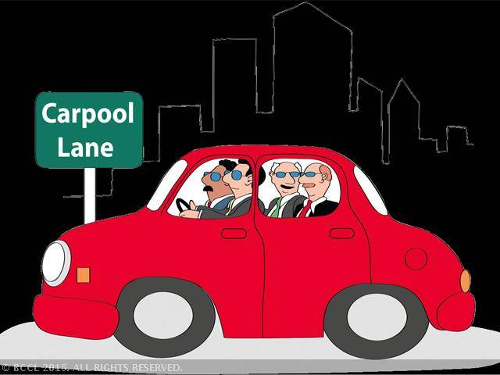
WHEELS WHEN YOU WANT THEM

Slide 3
IDEA & THE BASIS OF THE APPLICATION
The idea is unique in that it is only for the University of Glasgow compared to other existing services that cater for everyone. By supplying only the University of Glasgow, this provides both drivers and passengers with additional safety and security as those they are travelling with will be fellow students
As the University year contains multiple semesters with individual students having near identical schedules week on week, there will be a regular recurring supply and demand during particular times (e.g. 9 to 10, 3 to 5) therefore users will not be as reliant to chance to find an individual going in the same direction.
It also provides a single place for students to use compared to being split across multiple websites therefore making it difficult to find someone applicable and has the added benefit of allowing students to meet new people.

Slide 4
WHY IT IS USEFUL
The idea allows students to either save or make money for something they would be doing anyway (travelling to University) and provides a reliable form of transport.
The idea is unique in that it is only for the University of Glasgow compared to other existing services that cater for everyone. By supplying only the University of Glasgow, this provides both drivers and passengers with additional safety and security

Slide 5

WHO WOULD USE IT? Persona 1
Joe is a 1st year undergraduate student studying Physics at the University of Glasgow. He stays at home currently so commutes to University by train but he finds it an inconvenience with public transport often being unreliable. He would like to find a fellow University student who lives nearby to his home and attends the same campus who he can car share with.
Ideally he would prefer a student who is a similar age to his own and attends classes at similar times to minimize the necessity of either of them having to wait for one another. Joe only has a small amount of money available so would like to find as cheap and reliable

Slide 6

PERSONA 2
Ryan is a 3rd year student who is part of the Glasgow University American Football team - the Tigers. He stays in University accommodation and is unable to afford a car so he has to carry his equipment to and from where the team trains. After particularly taxing training sessions he has found the journey home rather difficult and he is concerned about losing some of his equipment on the way. Ryan would like to find an individual who can pick both himself and his equipment up every Tuesday at 18:00 after training and return them home.

Slide 7
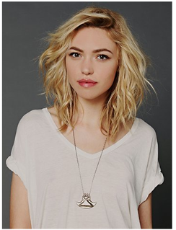
PERSONA 3
Jade is a 2nd year student at the University of Glasgow who would like to earn some extra money to help cover petrol costs. She regularly uses her car to travel into university due to time requirements not supporting the use of other transport methods. Therefore, she would like to find a few students that live local to her who require a lift into the Gilmorehill Campus for 9am starts. The students will be asked to pay for the lift but she is happy to split that accordingly depending on the number of students she drives in. Her car is rather small and as a result cannot cater for more than 2 students plus backpacks. Students carrying anything beyond this along with smokers are undesired.

Slide 8
MAIN REQUIREMENTS OF THE APPLICATION
For this web application, we are using the following requirements:
Django - Python framework (latest version is 1.9.2) . We are using the latest version
Pillow - This is a Python Imaging Library which is used to handle images in our web application
Database - By default, Django uses Sqlite3. But we are planning to used PostgreSQL in our web application. As lot of the blogs says that using PostgreSQL doesn't have any performance issues and also we can able to store large amount of data when compared to other databases.
CSS - We are using Bootstrap for the styling. Bootstrap is the most popular HTML, CSS and JS framework for developing web applicati
We are planning to include Javascript, JQuery and AJAX also in our web application.ons.

Slide 9
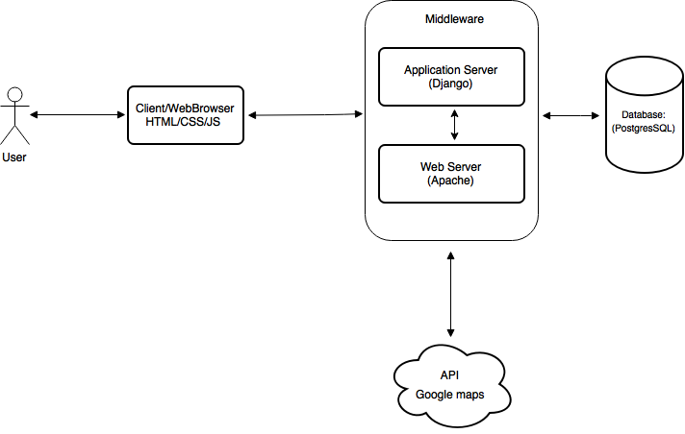
SYSTEM ARCHITECTURE

Slide 10
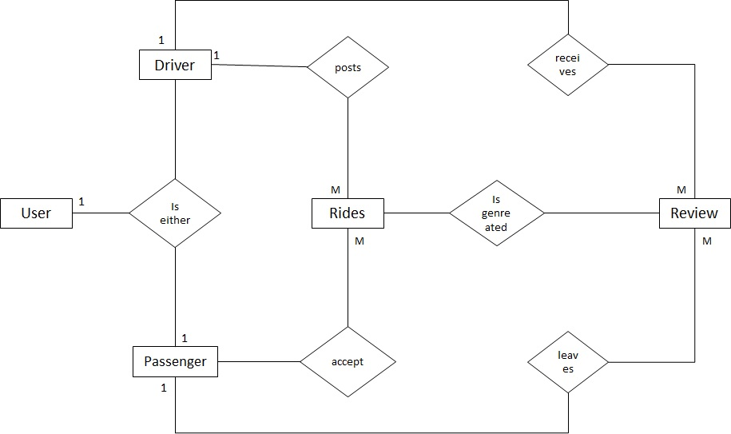
ER DIAGRAM(Compressed Chen)

Slide 11
ATTRIBUTES
User Detail table
Field | Type
Username | Char(30)
Password | Char(30)
Email | Char(30)
Firstname | Char(30)
Lastname | Char(30)
Phone | BigInt
Age | Int
ID | Varchar

Slide 12
ATTRIBUTES
Vehicle Detail table
Field | Type
Registration Number | Char(30)
Vehicle Make | Char(30)
Vehicle Model | Char(30)

Slide 13
ATTRIBUTES
Journey Detail table
Field | Type
Journey ID | Primary Key
Departure | Char(30)
Destination | Char(30)
Date | DateTime
Time | DateTime
Seats Available | Int
Cost | Int

Slide 14
ATTRIBUTES
Review Detail table
Field | Type
Description | Char(150)
Posted by | Char(30)
Posted at | DateTime

Slide 15
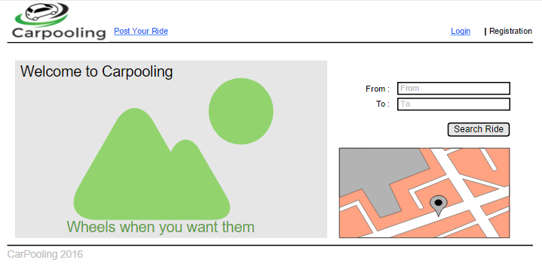
WIREFRAME

Slide 16
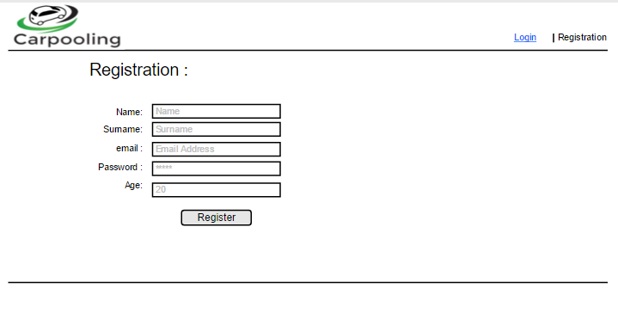

Slide 17
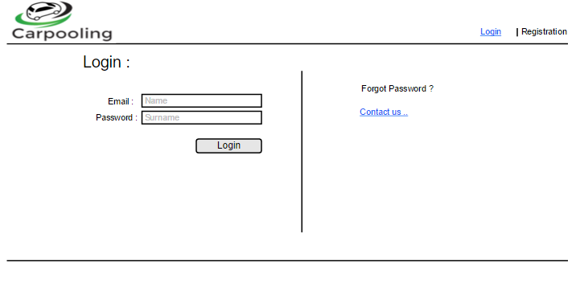

Slide 18
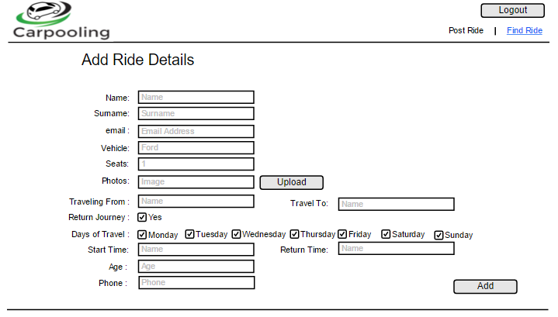

Slide 19
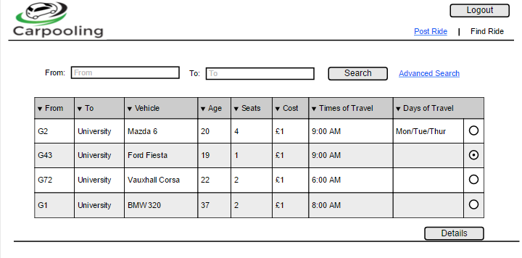

Slide 20
